Slide 1
Long read sequencing Ave Tooming-Klunderud, NCS/CEES/UoO, ave.tooming-klunderud@ibv.uio.no

Slide 2
Short read vs long read sequencing
Short read sequencing Long read sequencing
Amplification during sequencing No amplification needed
Short reads Long reads
High read accuracy Low read accuracy/high consensus accuracy
Requirements for input DNA:
Works with almost any DNA sample High quality DNA needed
Low amount High amount
Fragmented DNA DNA fragments at least 40kb long
Price:
Low High

Slide 3
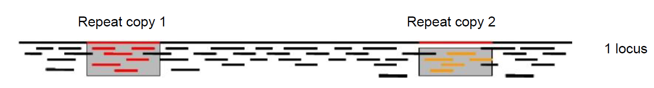
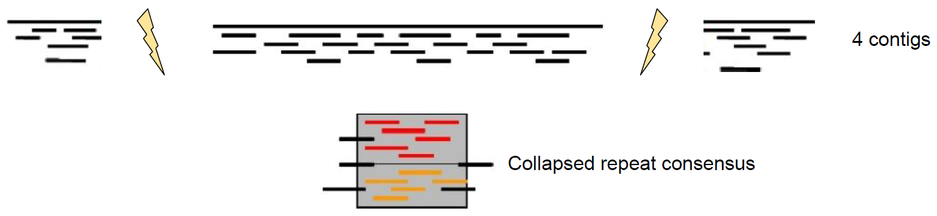
Why long reads?
Long reads can span repeats

Slide 4
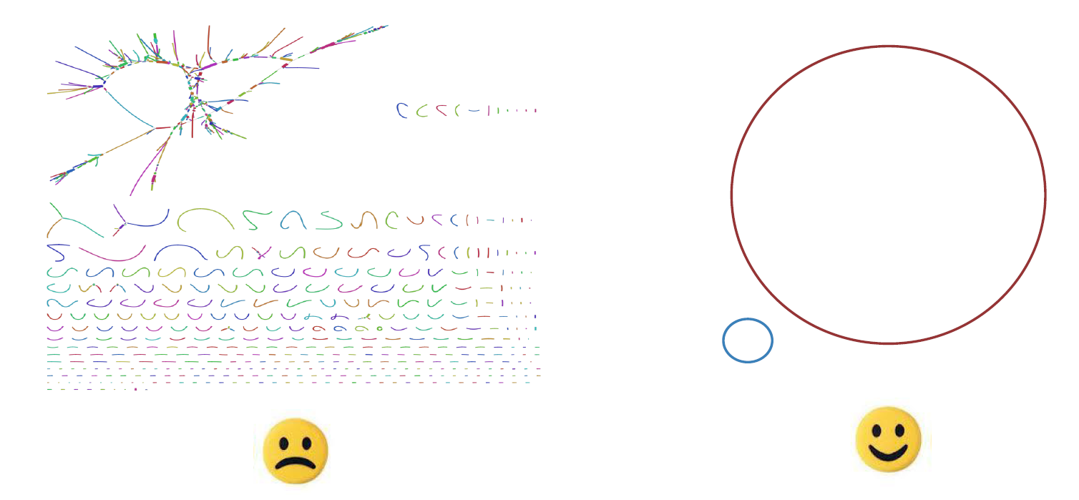
Why long reads?
Complete genomes

Slide 5
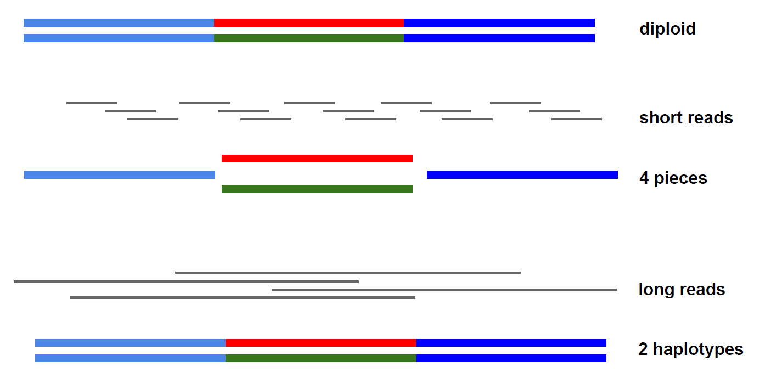
Why long reads?
Heterozygosity

Slide 6
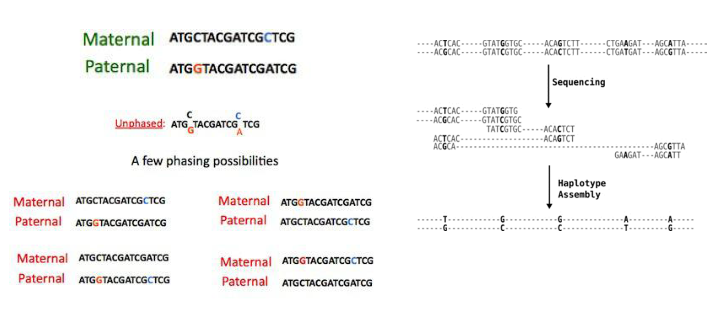
Why long reads?
Phased haplotypes

Slide 7
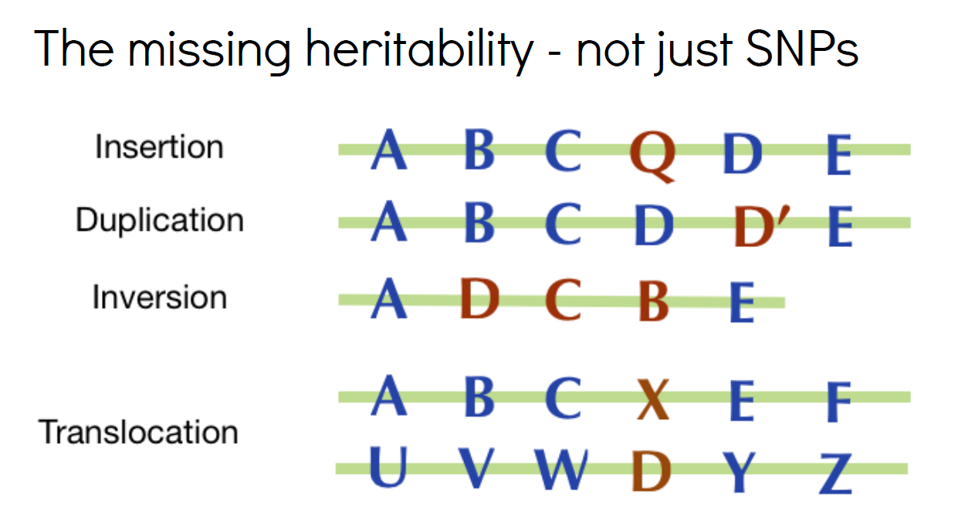
Why long reads?
Structural variation

Slide 8
Long read sequencing
Single DNA molecule is sequenced (no amplification is involved)
Entire genome can be sequenced, also GC/AT rich regions
Possible to detect DNA modifications
Two companies – two different technologies:
Pacific Bioscience – SMRT sequencing
Oxford Nanopore – Nanopore sequencing

Slide 9

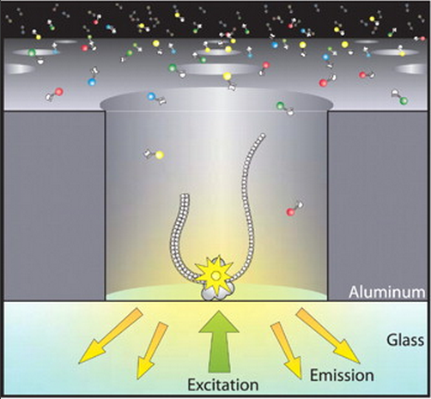
The PacBio sequencing technology
Based on the observation of DNA synthesis in real time and involves:
Single DNA molecule bound to the polymerase
SMRT cell
Phospholinked nucleotides
The PacBio RS II or Sequel instrument
Zero-mode waveguide

Slide 10
The PacBio sequencing technology

Slide 11
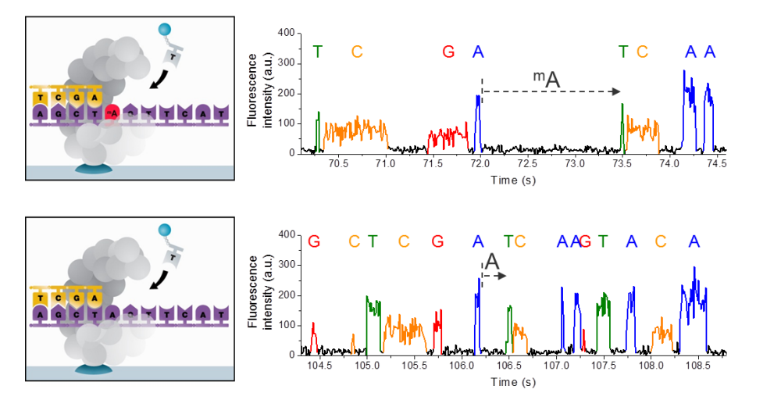
Base modifications
6-mA and 4-mC - 100 x coverage needed for detection
5-mC – 1000 x coverage needed

Slide 12
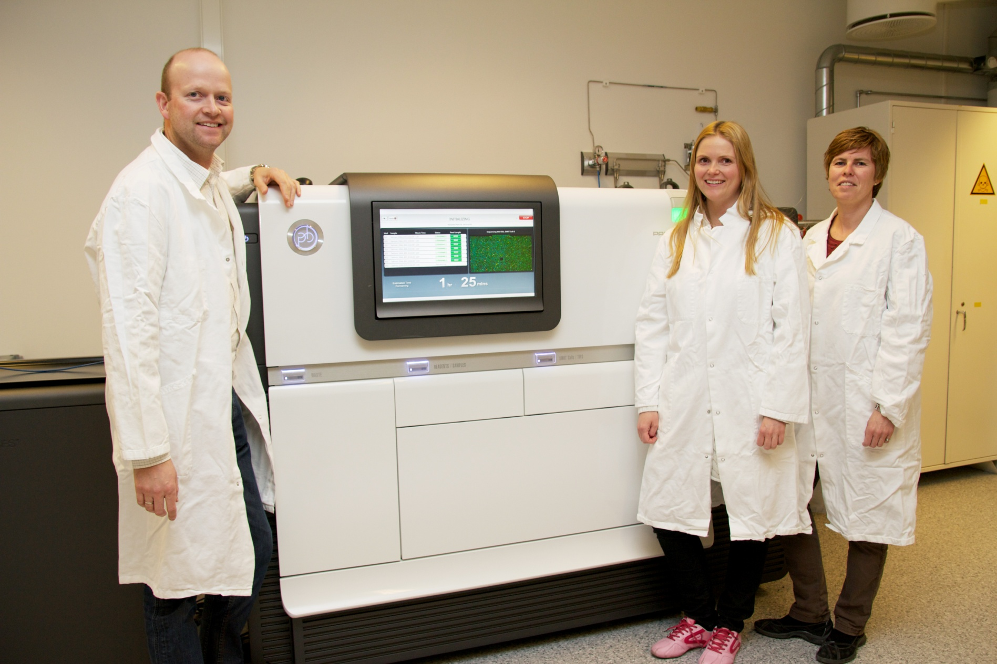
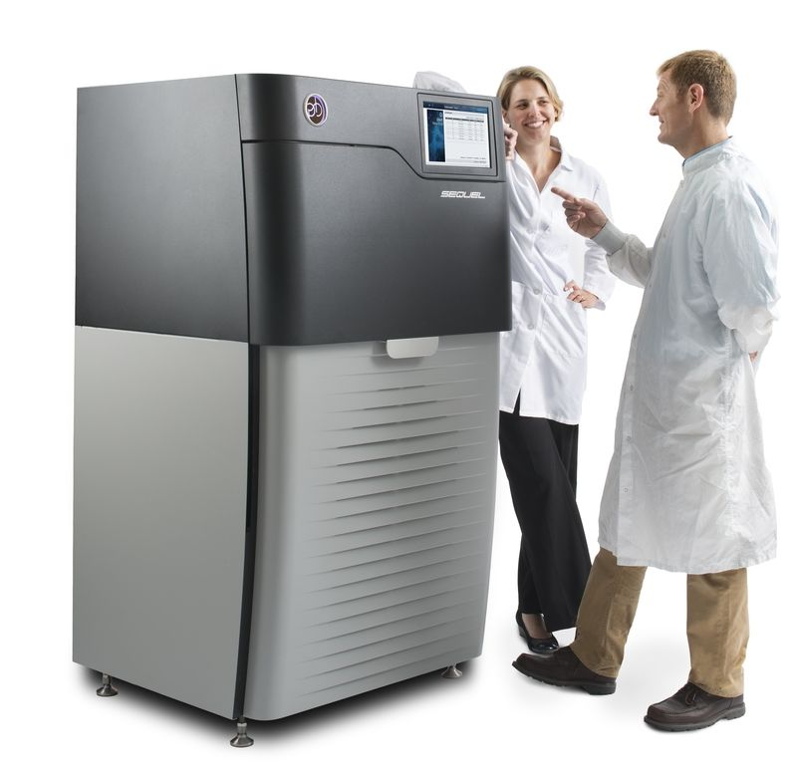
Instruments
RS II Sequel

Slide 13
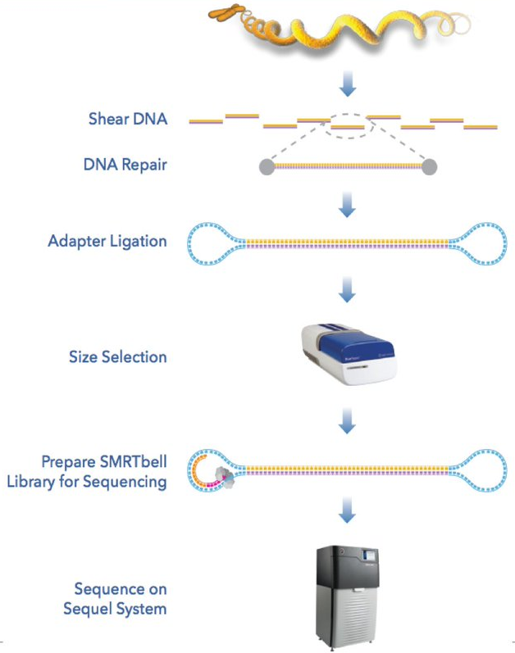
Library preparation

Slide 14
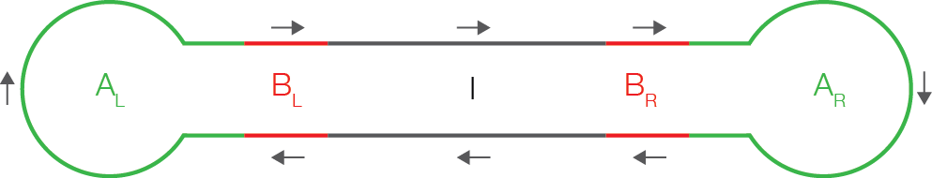
Sequencing

Slide 15
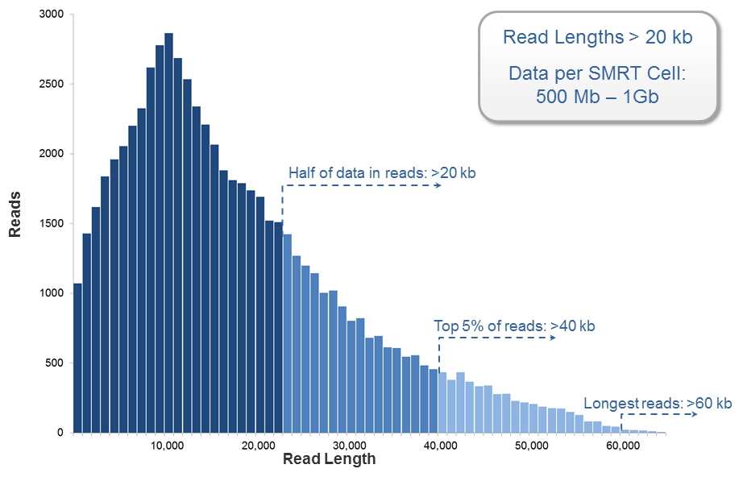
Sequence performance: polymerase read length

Slide 16
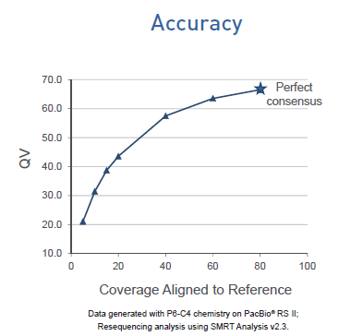
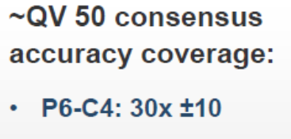
Sequence performance: accuracy
Single read accuracy 85-90 %
Lack of systematic sequencing errors
99.999% (QV50)

Slide 17
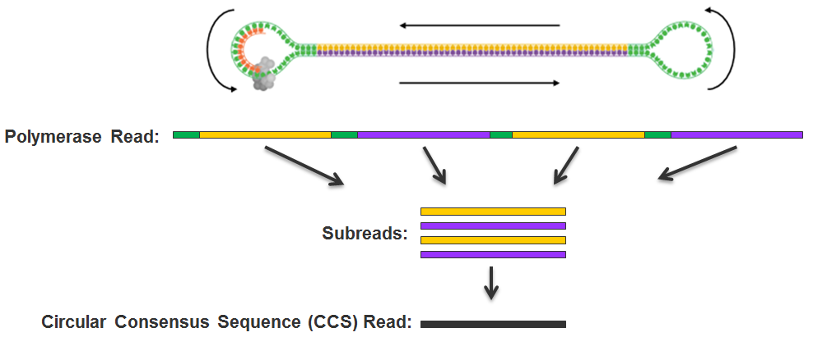
Consensus accuracy – short template
http://files.pacb.com/software/smrtanalysis/2.2.0/doc/smrtportal/help/!SSL!/Webhelp/Portal_PacBio_Glossary.htm

Slide 18
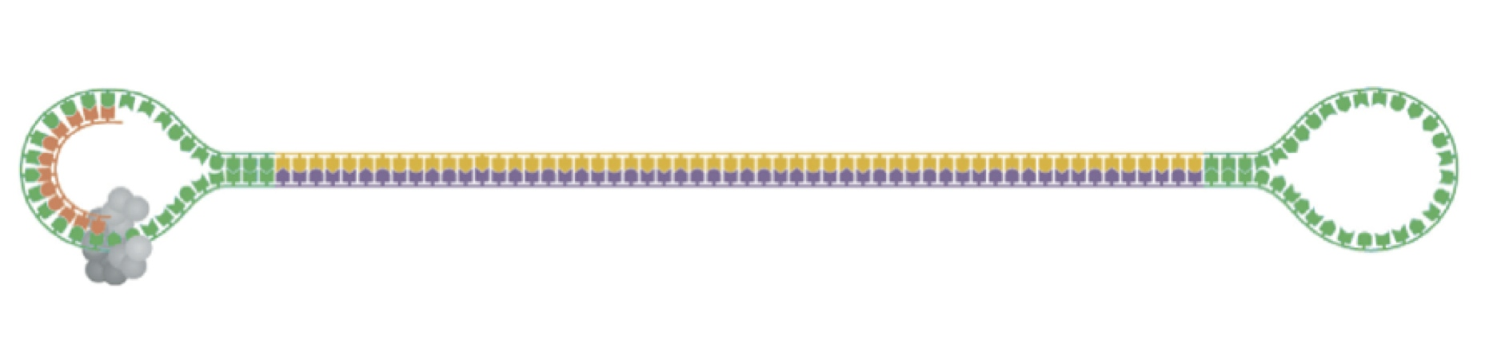
Consensus accuracy – long template
Genomic DNA: de novo assembly (60-100 x coverage needed)
Long amplicons: consensus is built using subreads from different fragments
Using
this…
to error-correct
this
doi:10.6084/m9.figshare.818957

Slide 19
Sequence performance: uniformity
Lack of GC content or sequence complexity bias
Ross et al. (2013) Genome Biology, 14:R51 doi:10.1186/gb-2013-14-5-r51.

Slide 20
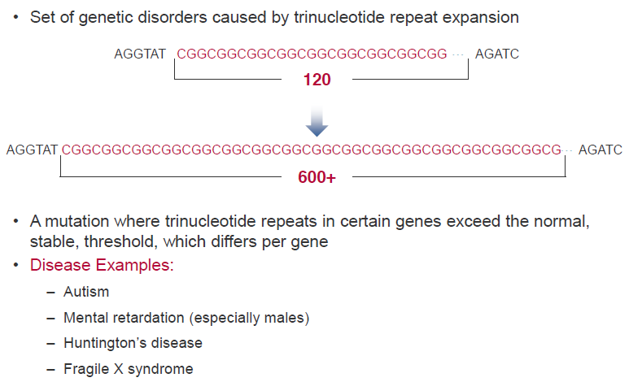
Sequence performance: uniformity
High GC - Trinucleotide Repeat Disorders

Slide 21
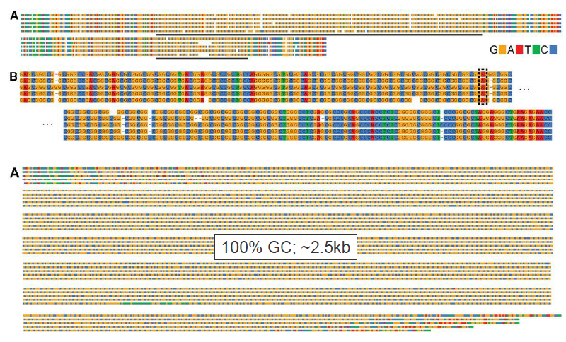
Sequence performance: sequencing the unsequenceable

Slide 22
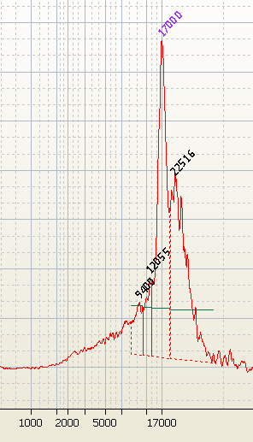
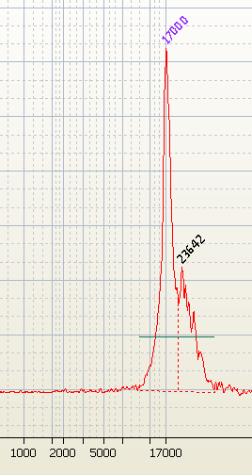
It’s all about the library!
Aim for looooong insert sizes
Only possible with high-quality DNA
Gentle, controlled fragmentation (Megaruptor)
Size selection of final library using BluePippin
Same library before and after BluePippin size selection

Slide 23
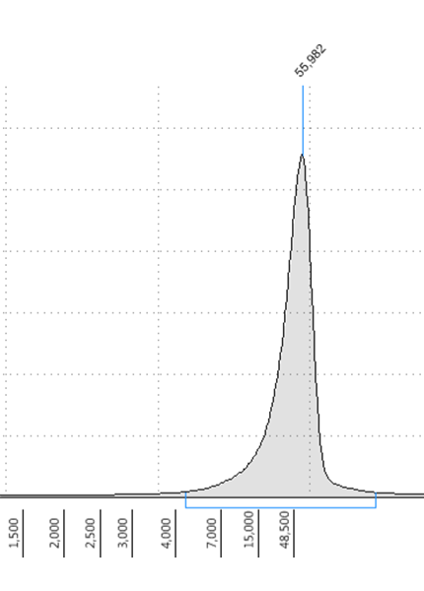
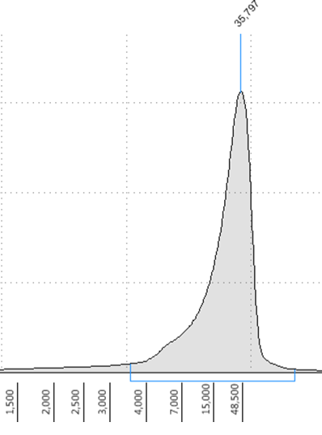
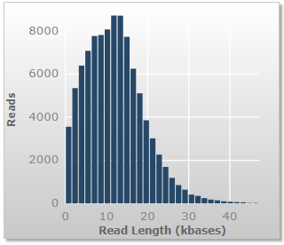
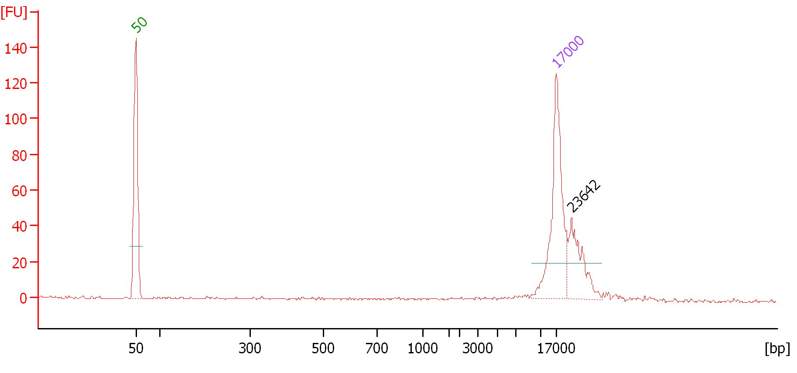
High-quality DNA sample
High-quality gDNA
Gentle fragmentation
Final library size selected using BluePippin
Average length of insert reads: 12.5 kb

Slide 24
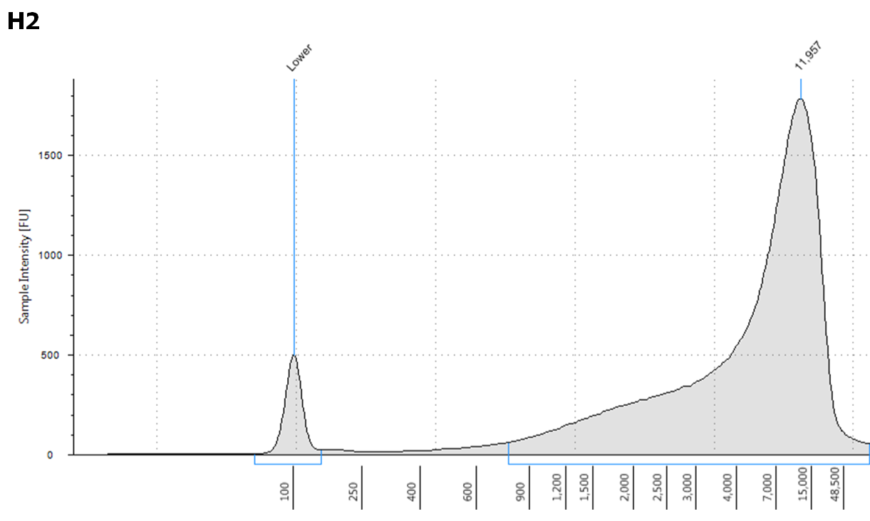
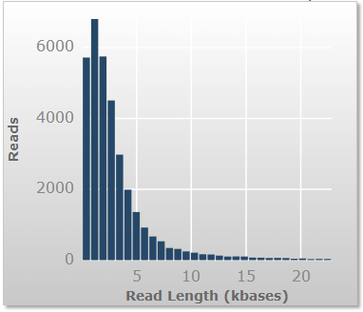
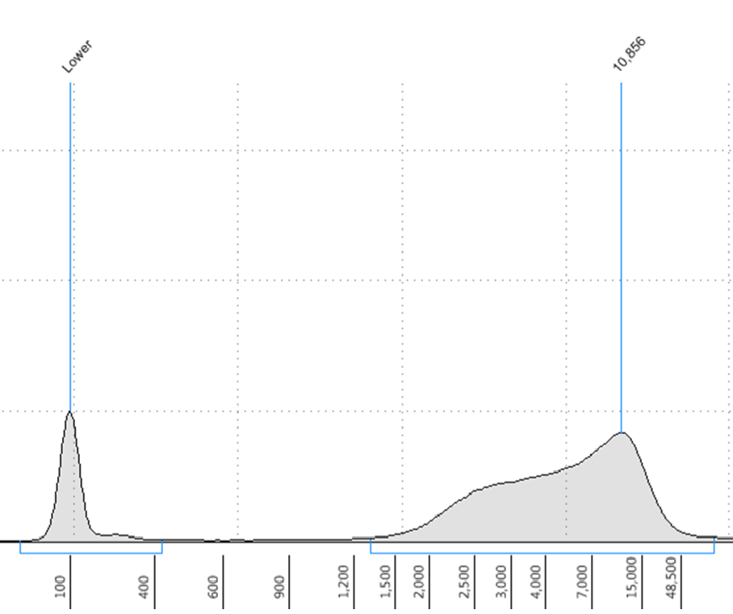
DNA sample with bad quality
Highly fragmented gDNA
Fragmentation not needed before library preparation
Average length of insert: 2.4 kb

Slide 25


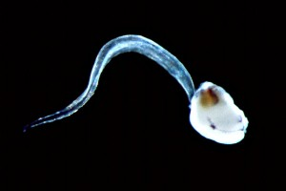


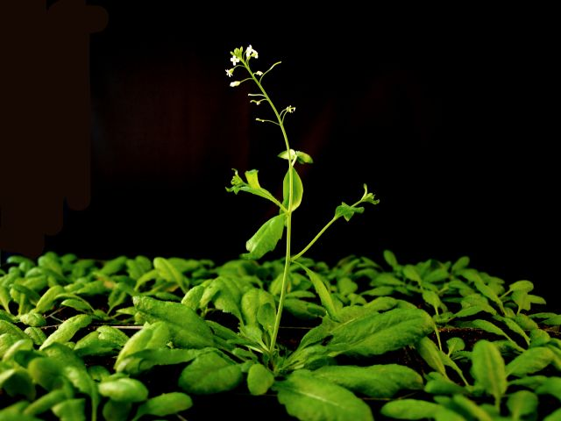


Applications – some examples
de novo sequencing
small genomes – PacBio only
large genomes – short read sequencing used for error correction
Transcriptomics
Full-length transcripts – no assembly needed
Amplicon sequencing
Short amplicons (<2kb) - ITS, 16S etc
Long amplicons – viruses, HLA typing
DNA methylation studies

Slide 26
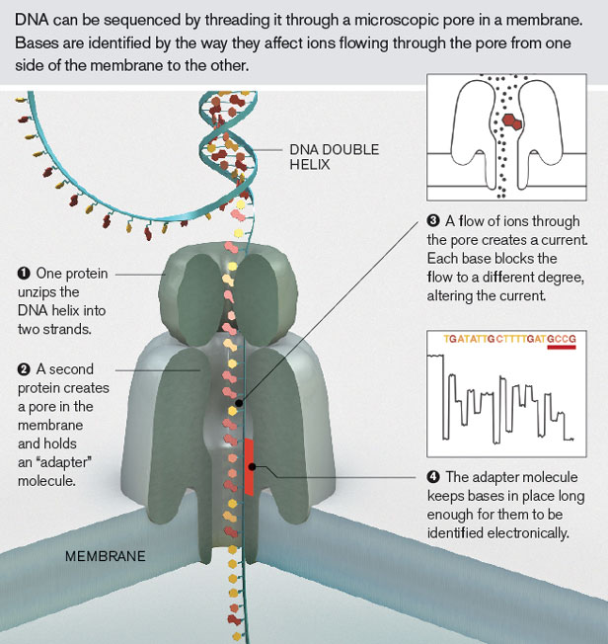
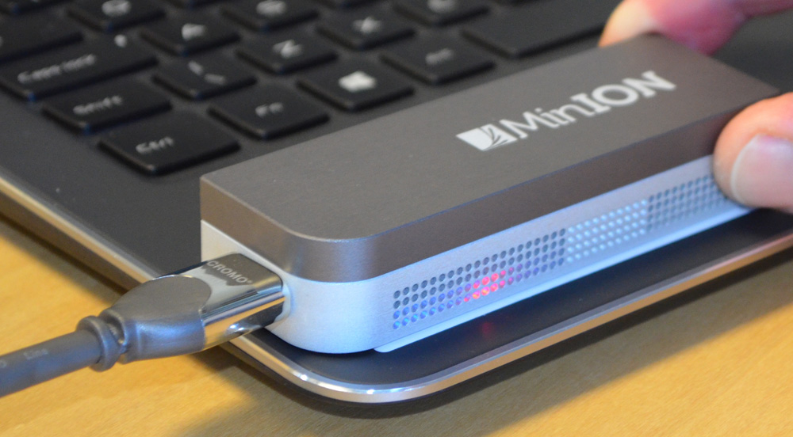
Oxford Nanopore sequencing technology
Nanopore vs PacBio:
«newer» technonlogy – not so well-established as PacBio
MinION – user-friendly
no instrument cost
small instrument, can be used wherever
Easy library prep
Non-random sequencing errors:
Homopolymers
A->G

